Slide 1

EMPLOYEES ATTRITION

Slide 2
LINKS
https://colab.research.google.com/drive/12uVmDRdn56VBvN3iV7pqdh_iYjSVm44g?usp=share_link (python Colab note book)
https://public.tableau.com/app/profile/p.yashoda/viz/MontlyIncomevsAttrition/EmployyesAttrition?publish=yes

Slide 3
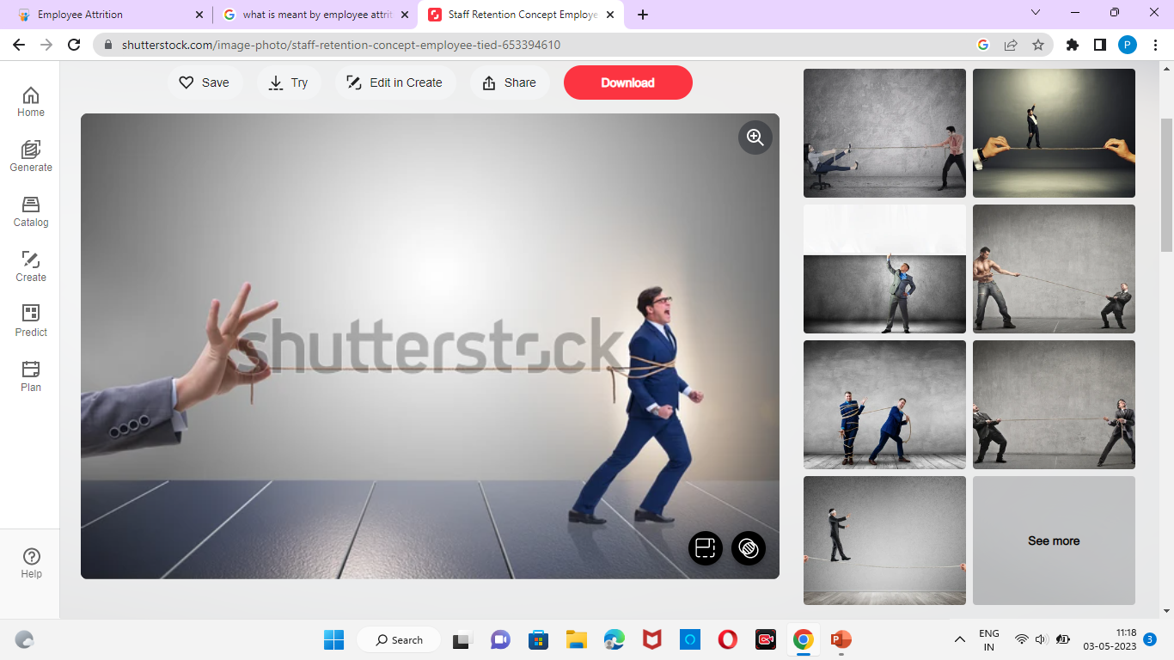
Attrition
Attrition is the departure of employees from the organization for any reason (voluntary or involuntary), including resignation, termination, death or retirement, termination, death or retirement.

Slide 4
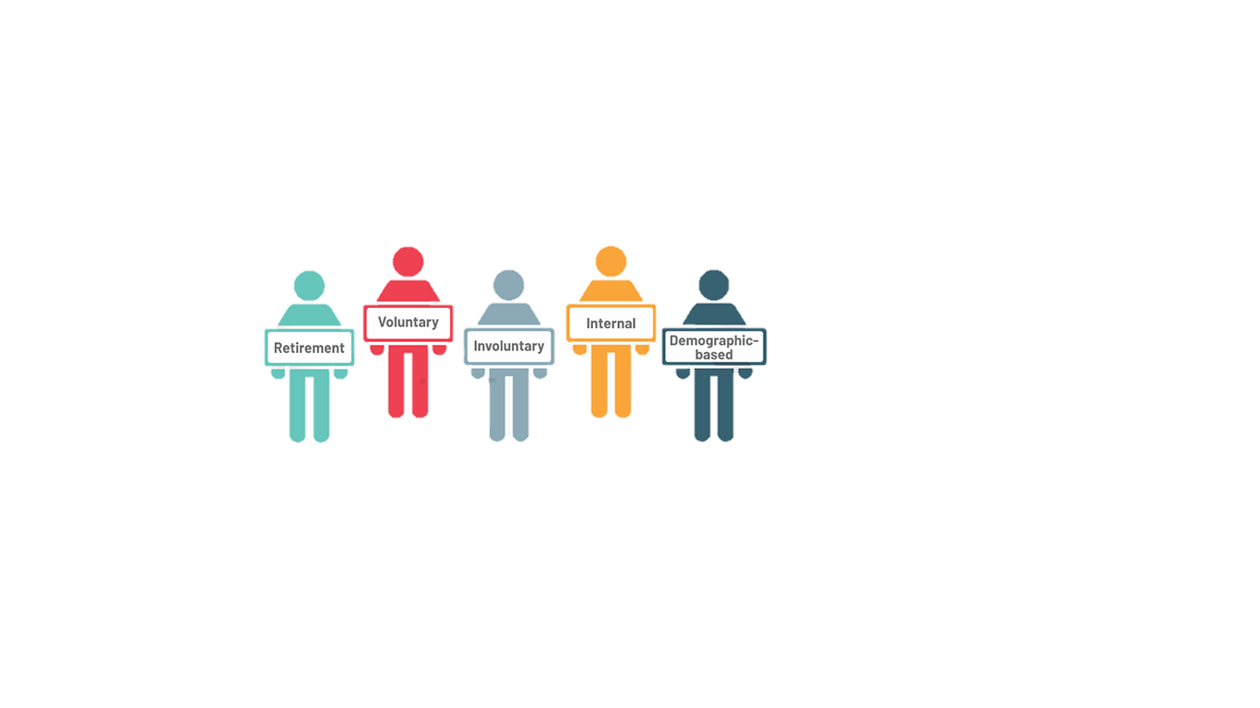
Types of attrition

Slide 5
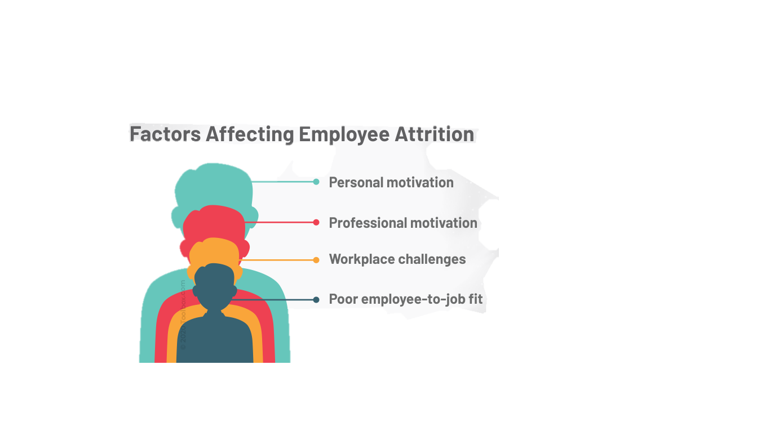
Factors Affecting Employee Attrition

Slide 6
Can Attrition Be Beneficial?
Interestingly, attrition isn’t always a bad thing. In many cases, turnover can actually be good for business for the following factors:
Poor-performing employees leave your company, reducing overheads and making room for new talent.
In one-dimensional workplaces (for example, tech companies employing a disproportionately large number of men), attrition can enable diversity.
It roots out employees who aren’t a good fit for their job and probably shouldn’t have been hired in the first place.
It helps to create a dynamic workforce, as the same employees with the same perspectives aren’t running the company for decades on end.
It is required in times of structural alterations, like when you’re pivoting towards a new business direction or have insufficient funds.

Slide 7
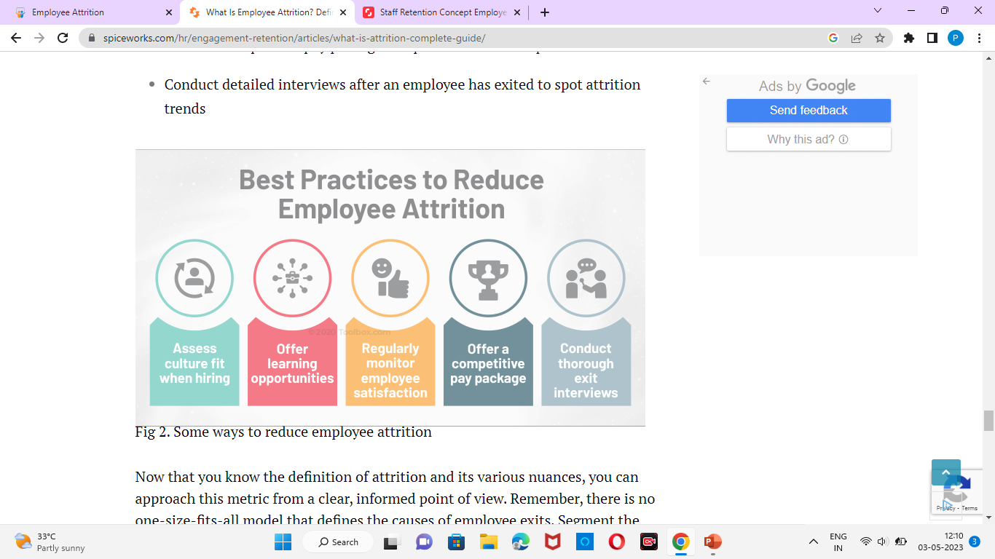
Best Practices to Reduce Employee Attrition

Slide 8
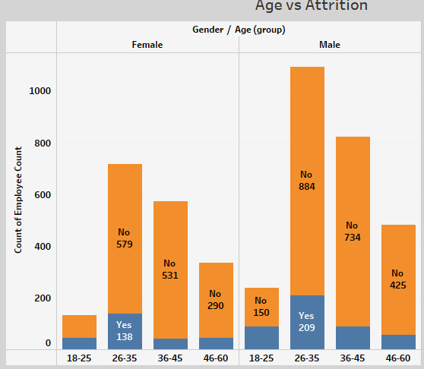
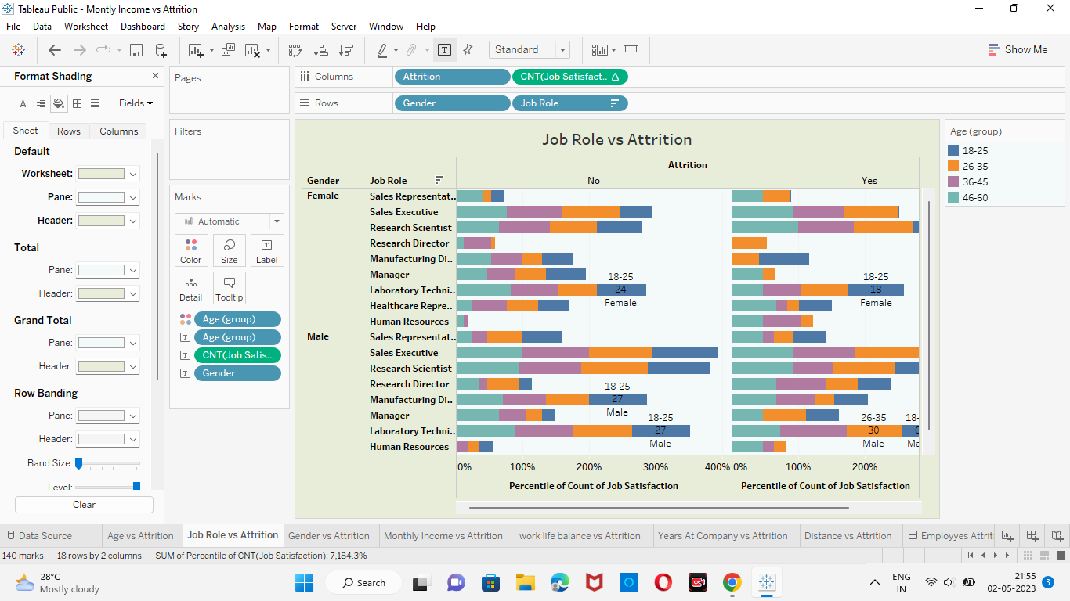
My Designs About Employee Attrition

Slide 9
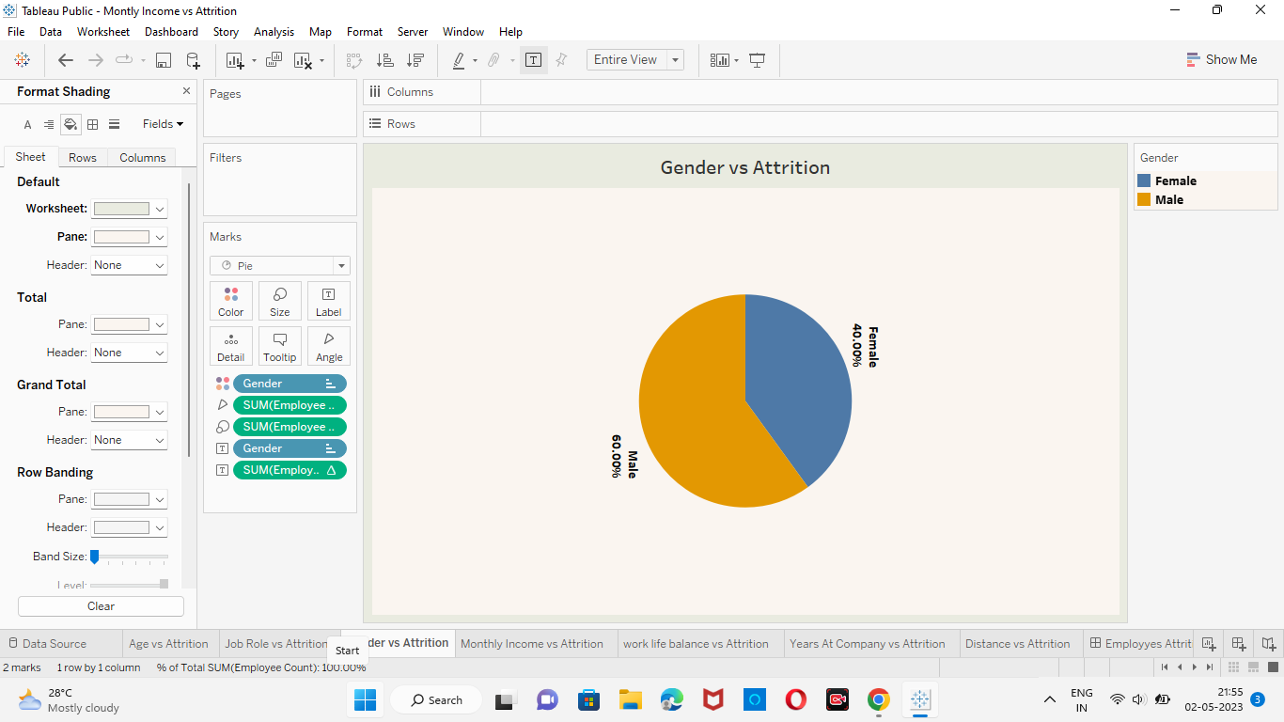
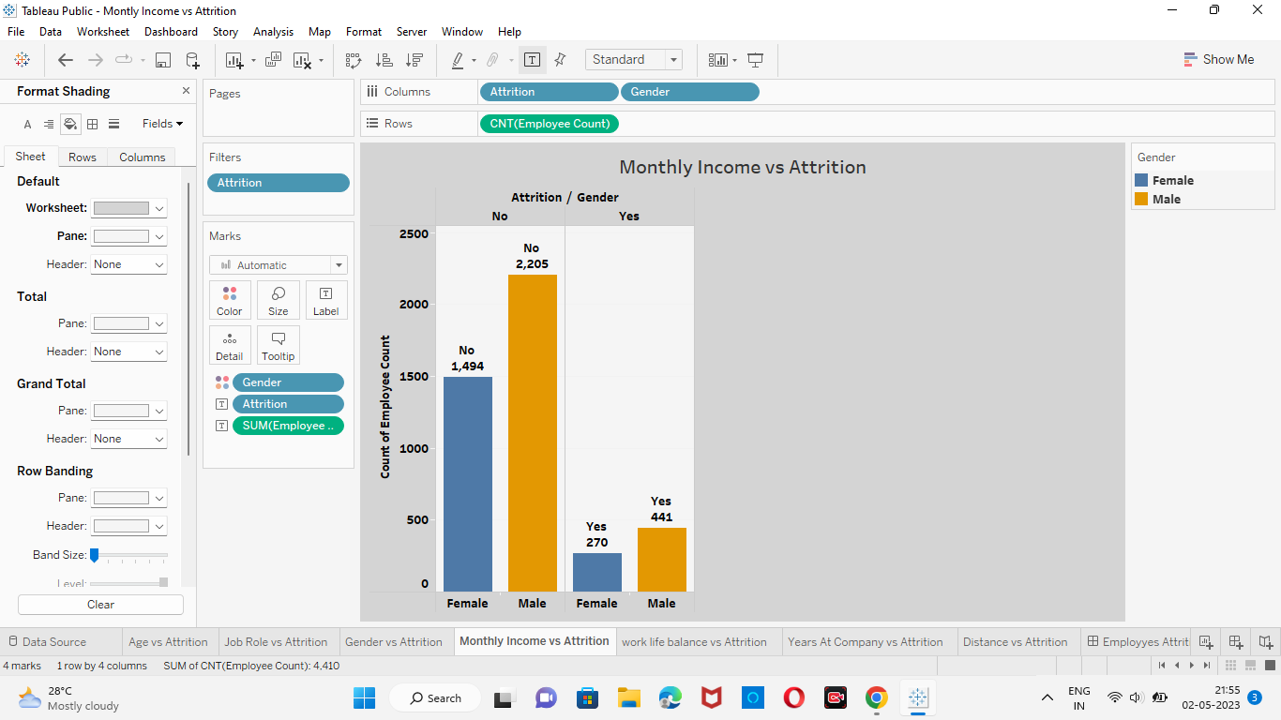

Slide 10
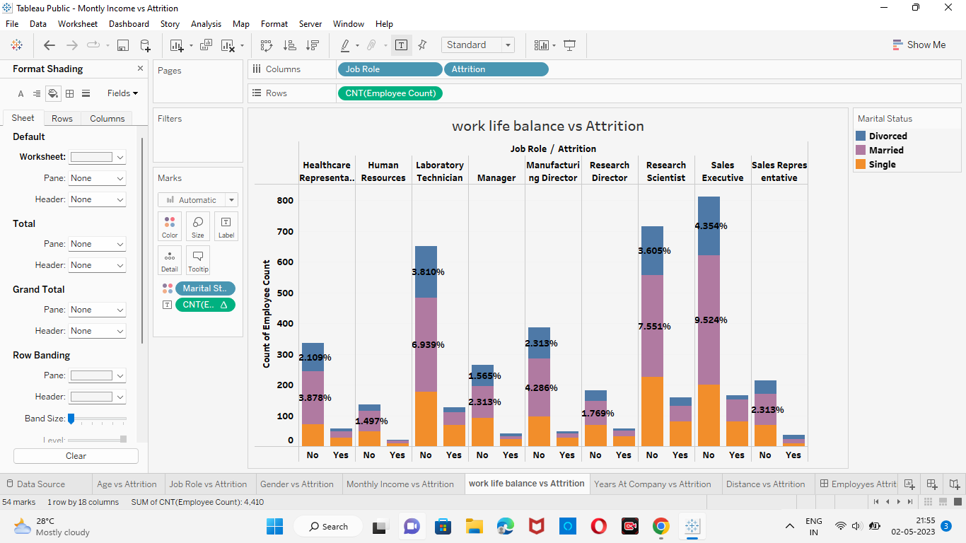
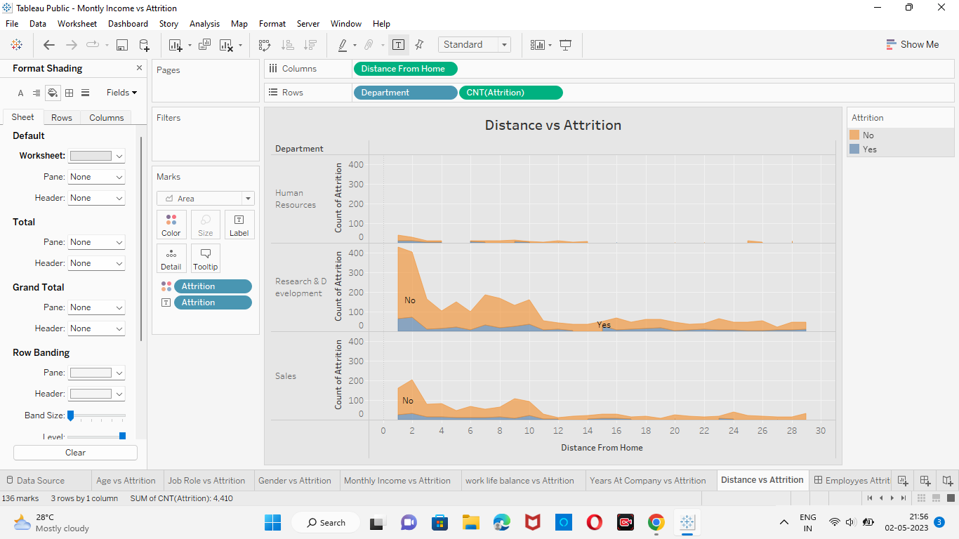

Slide 11
Conclusion
While employee attrition isn't necessarily a bad thing, you should do your best to monitor the pulse of your workplace to stop it in its tracks as early as you can.

Slide 12
